Slide 1

Introduction to cypress
(Not Sponsored)
** Opinions and view points in this presentation may not be the opinions and viewpoints of anyone.

Slide 2


Introduction
Who am I and what is todays Agenda
What is cypress / what is it not.
Simplified case study
Pitfalls and best practices unique to Cypress

Slide 3
What is Cypress
https://www.cypress.io/
The web has evolved. Finally, testing has too.
Fast, easy and reliable testing for anything that runs in a browser.
Runs fast tests in the browser
Cypress is free*
SaaS model
*Parallel scheduling = $$

Slide 4
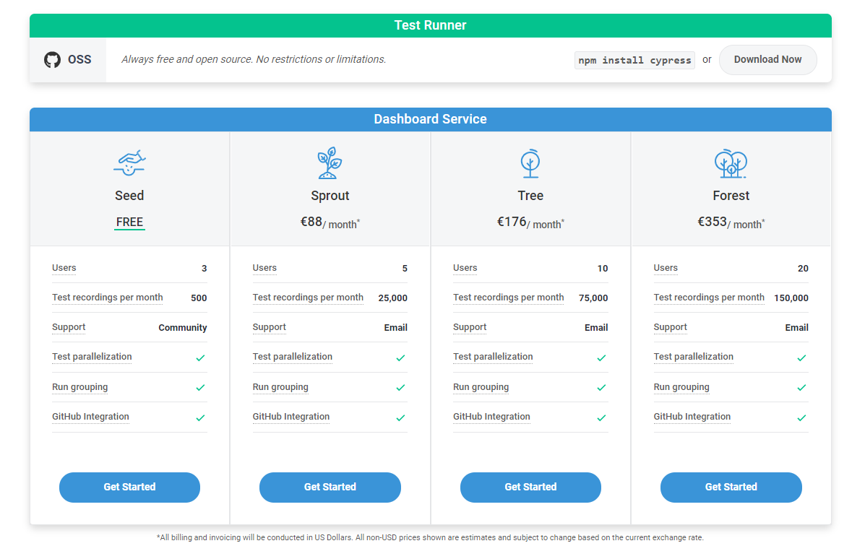

Slide 5
How does parallelism work
Spin up multiple machines/docker instances to act as a cypress runner
Register the runner with cypress using a key
Trigger the entire test solution on each instance
Cypress schedules tests as machines become available

Slide 6
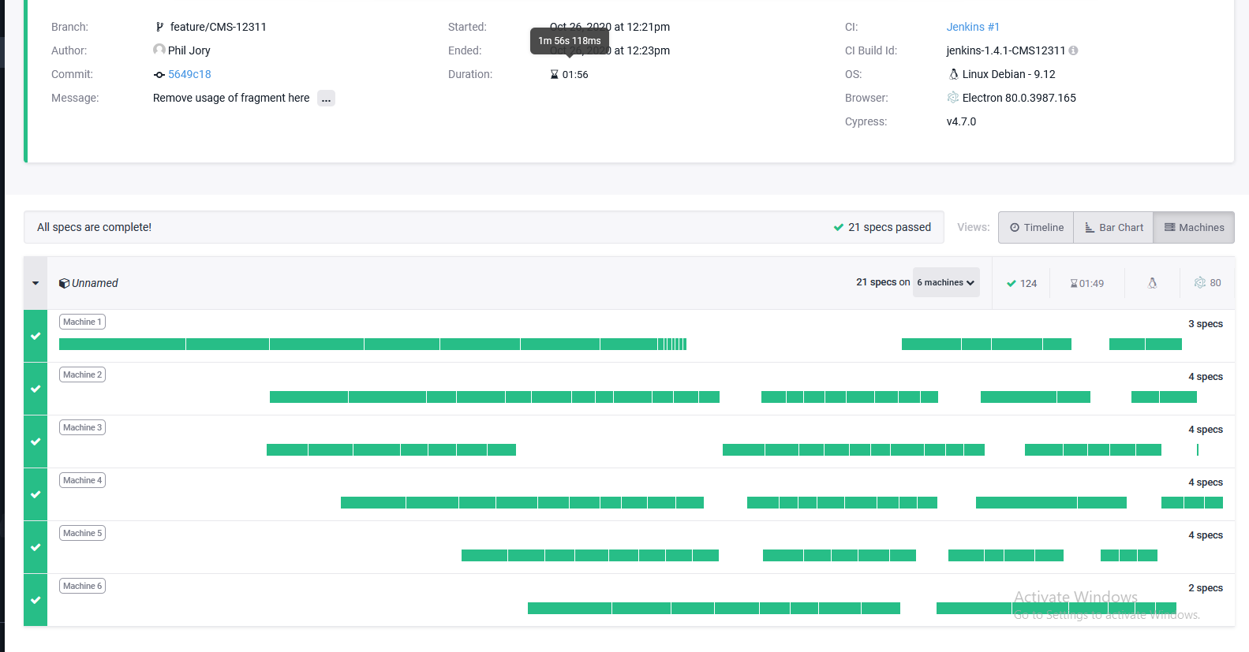

Slide 7
Can you run in parallel for free?
Yes! (see I told you I wasn’t sponsored)
Within your build system i.e. Jenkins, Select all .test.js files in the solution
For each item in the list (or split into multiple)
Spin up a machine/docker instance
Launch cypress with a given test file
Use one of the many supported report formats

Slide 8
Can you run in parallel for free?
its might not be worth it
Dashboard and uploading of videos on failure
Parallelization is less efficient
You get many runs for your subscribtion
Custom payment plans exist
But it might be useful in some scenarios

Slide 9
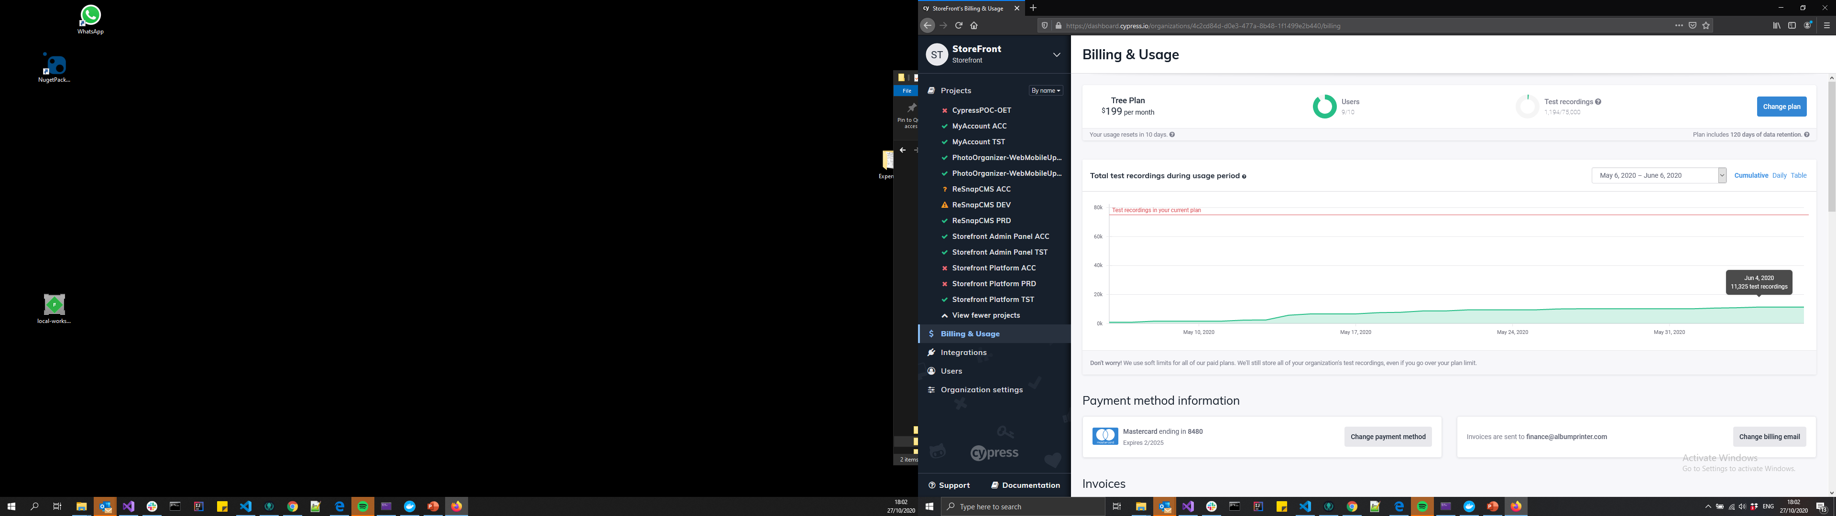
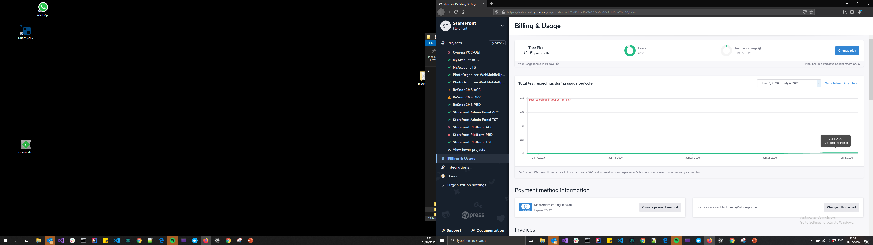

Total Test Recordings- What do we use

Slide 10
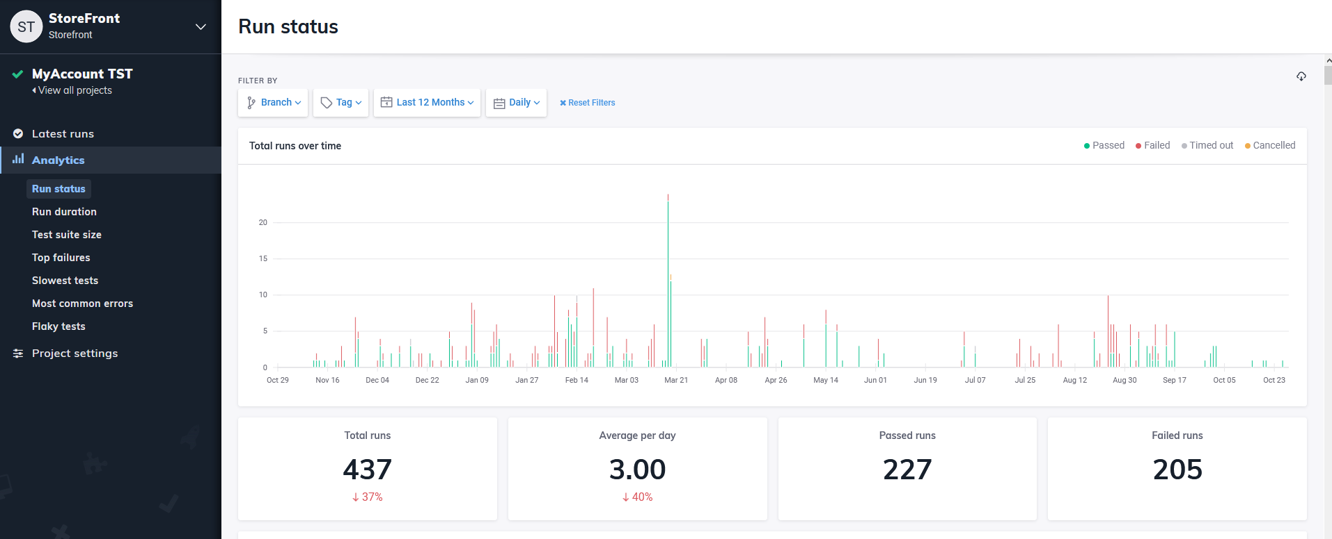
Total Test Recordings- What do we use

Slide 11
What is cypress not
Not a general purpose automation tool.
Runs inside of a single browser tab browser.
You cannot use Cypress to drive two browsers at the same time.
It will never support multiple tabs

Slide 12
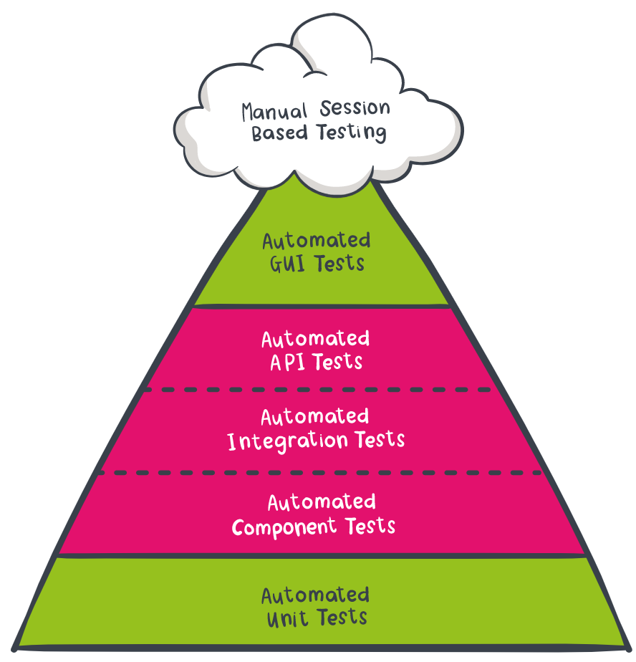
What is cypress (not)
Limitations prevent it from testing every possible GUI scenario.
I.e. limited to certain web browsers
Quicker and easier to use and setup than other more complete UI testing applications and well integrated with the browser
Mocking and stubs allow you to test in isolation

Slide 13
Case Study – Albums (Loading Data)
“Albums” app
Accesses an open API that returns placeholder data & displays them
For the top 10 albums it loads all the photos in the album
A button is provided to load the phots of other albums

Slide 14
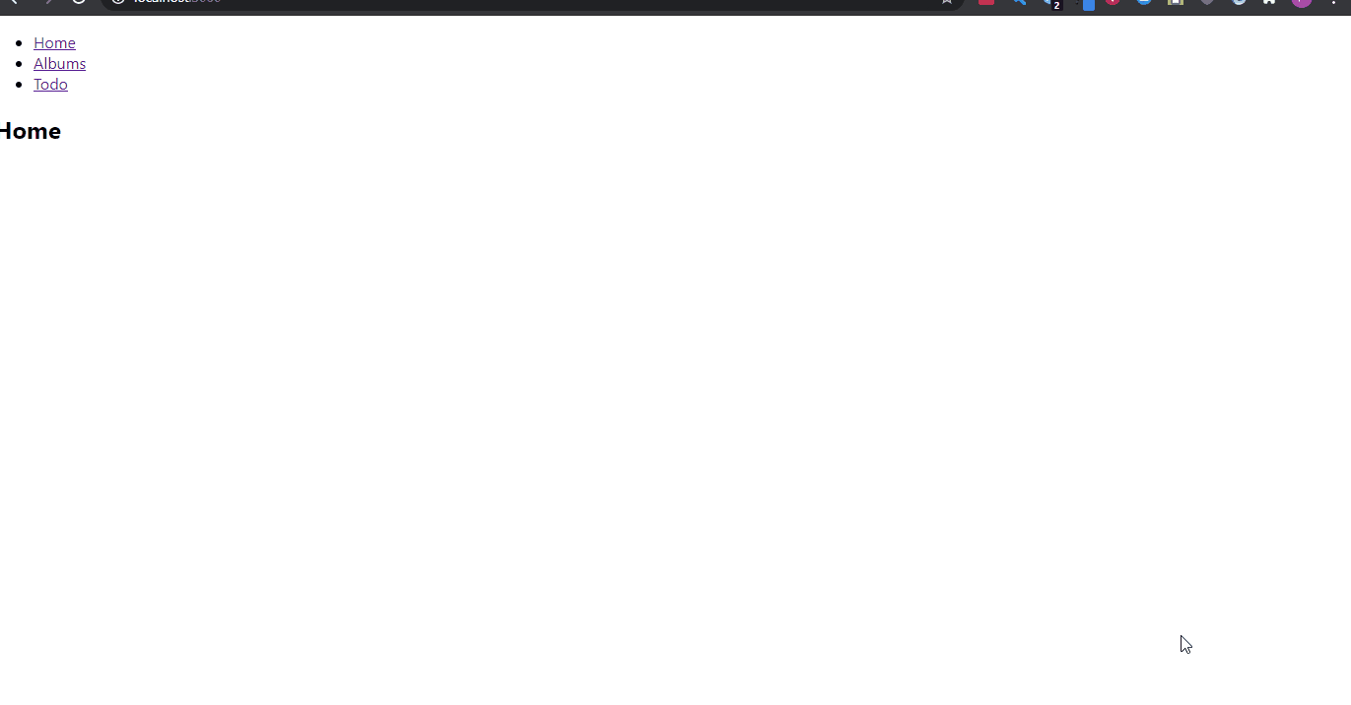
Case Study – Albums (Loading Data)

Slide 15
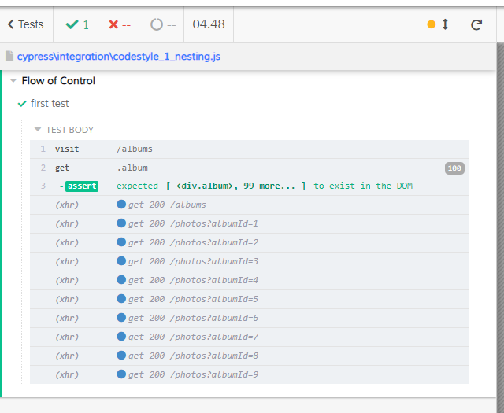
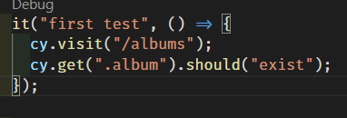
Case Study – First Test
Website Loading

Slide 16

Code Style / Flow of Control
Cypress supports a mixture of asynchronous (promises) and synchronous code styles
Cypress will always execute code the in a synchronous manner
The next 3 examples all result in the same execution but the clarity offered by the code differs

Slide 17
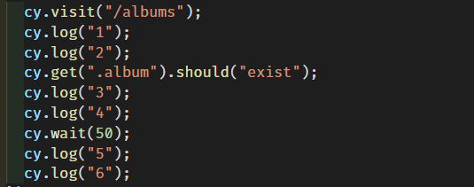
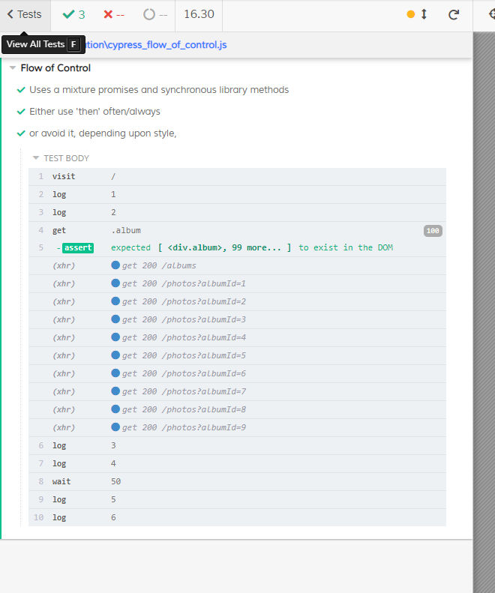
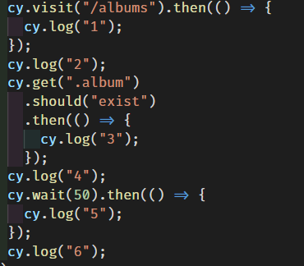
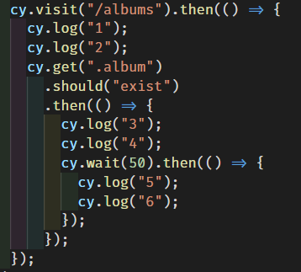
1.
2.
3.

Slide 18
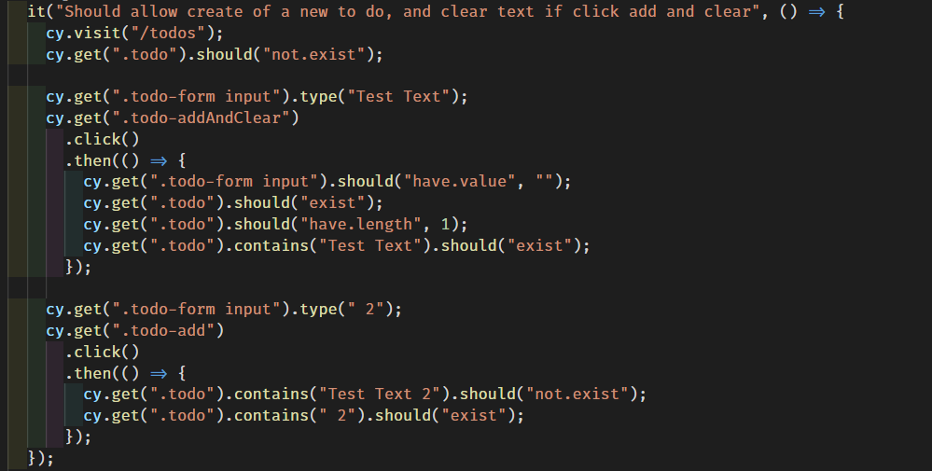
But nesting can add meaning if used appropriately

Slide 19
But nesting can add meaning if used appropriately
Visit Page
Setup
Click Button
Assert Results
Setup
Click Button
Assert Results

Slide 20
Case Study – To Dos (executing actions)
“ToDo” app
Stores data in local storage
User can
Add and keep their text
Add and clear their text
Remove existing items
User can not add an empty item

Slide 21

Case Study – To Dos (executing actions)

Slide 22
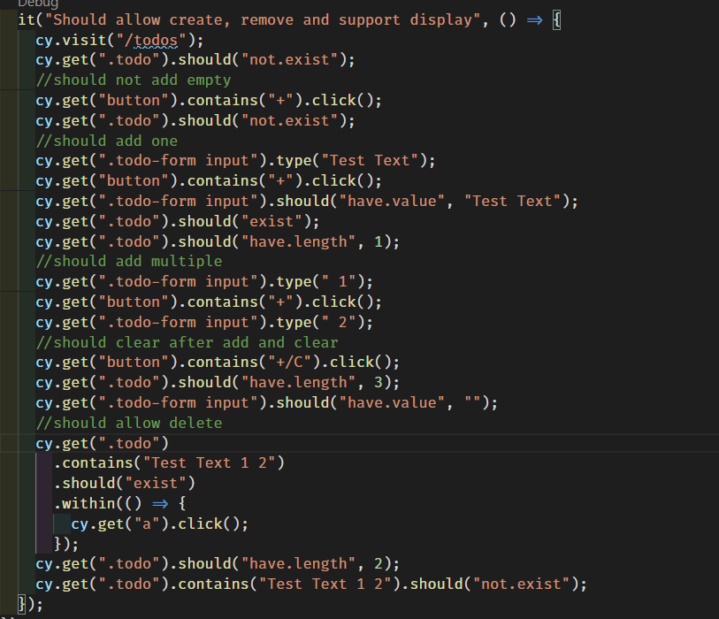

Slide 23
Visit Page
Test
Validation
Test
Add
Test Add
and Clear
Test
Delete

Slide 24
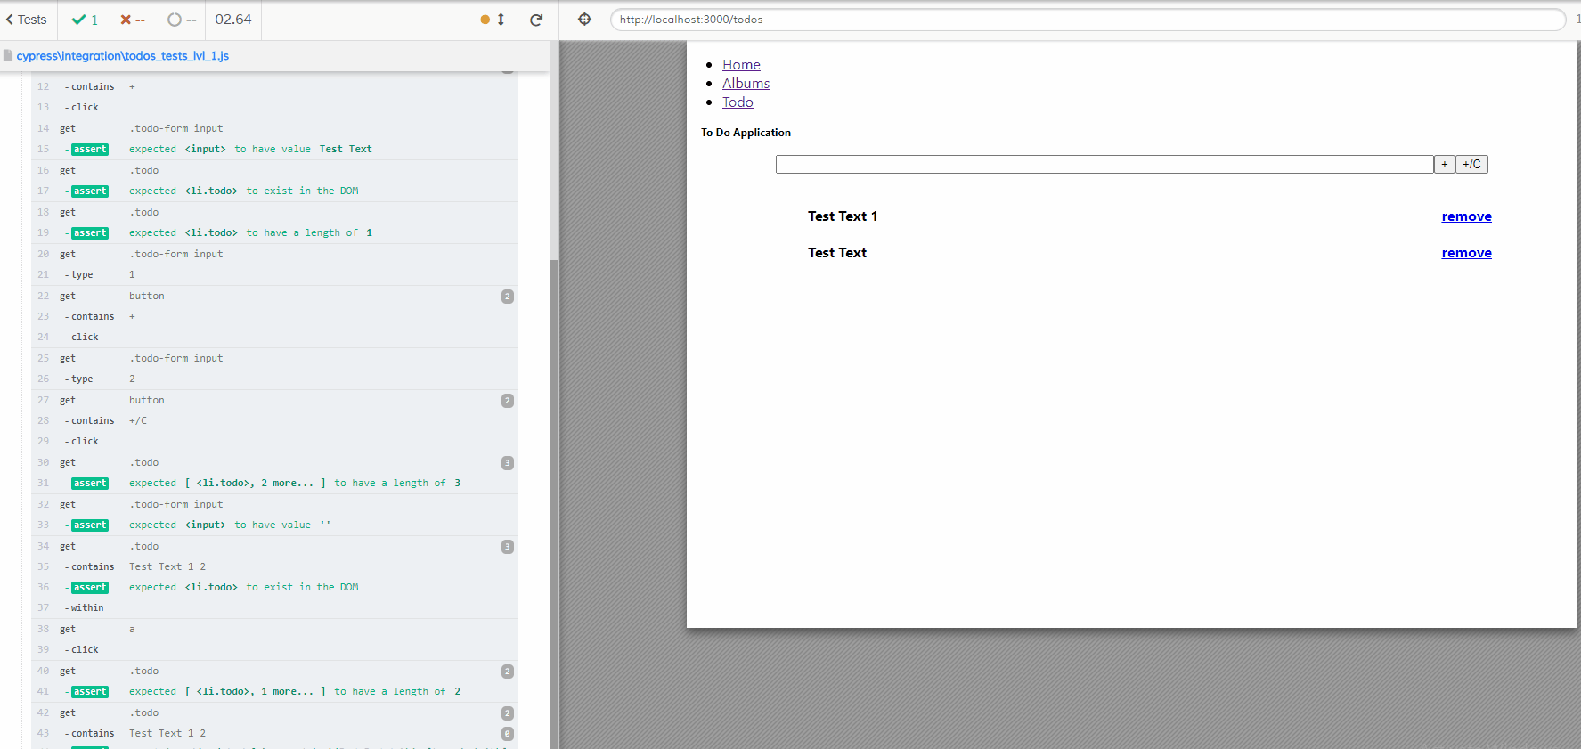

Slide 25

Pitfalls Retry & Waiting
Always check at least one thing (e.g. should(“exist”)) if you look it up
Checks work like check points in the cypress flow
Once a check passes it will not be retried
Cypress build in checks will automatically retry
There is a default timeout
Waiting before checking (and starting the check/retry cycle) can increase reliability

Slide 26
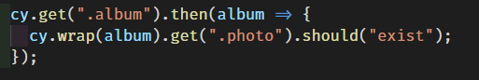
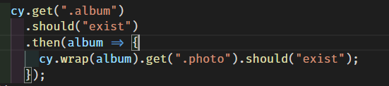
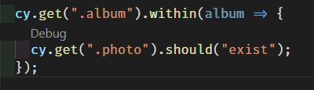
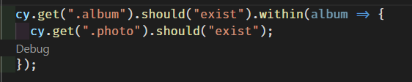
Pitfalls, Retry
Get ParentItem (it doesn’t exist)
Get From ParentItem (null) internal Child Item (it doesn’t exist)
Check Child Should Exist (it does not *see above)
Cypress automatic retry from previous get => 2.
Get From ParentItem (null)
Get ParentItem is not called again, so its children will never be found.
Get ParentItem (it doesn’t exist)
Check Child Should Exist (it does not *see above)
Cypress automatic retry from previous get => 1.
let’s say it does exist next time
Get From ParentItem (found) internal Child Item (it doesn’t exist)
Check Child Should Exist (it does not *see above)
Cypress automatic retry from previous get => 3.
will retry until it passes or times out

Slide 27
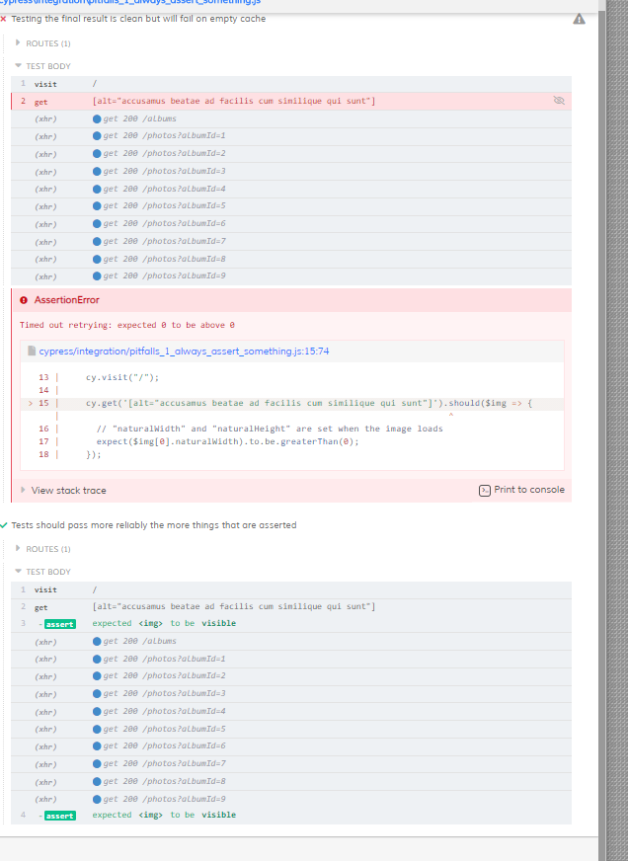
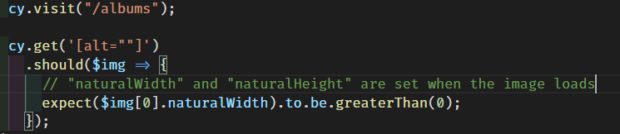
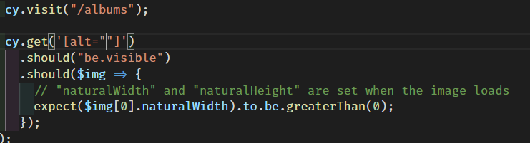
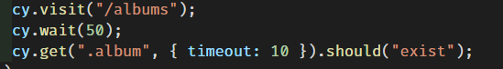
Pitfalls, Retry & Waiting
Rely upon the automatic retry
One possible solution would be to manually wait

Slide 28
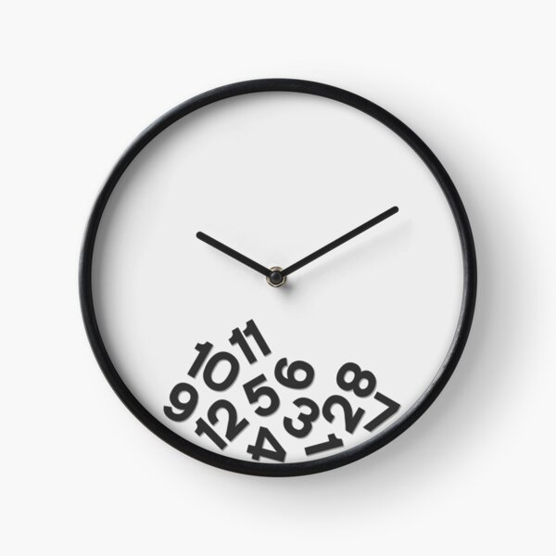
The Problems with Waiting
Waiting for arbitrary times is an anti-pattern
Waiting for things that are outside the scope of the test is wasteful
i.e. Is the Api health part of this test or not?
e.g. Analytics
Test things once and programmatically bypass them in other cases
e.g. User Login (should not test the login screen on every test)

Slide 29
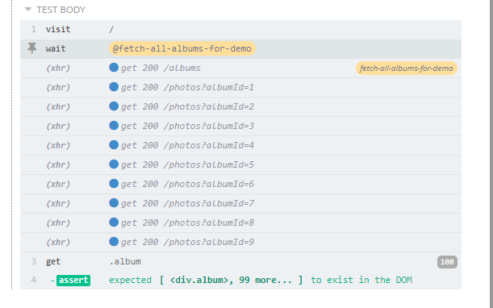
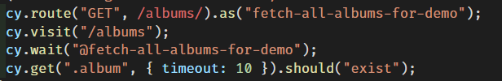
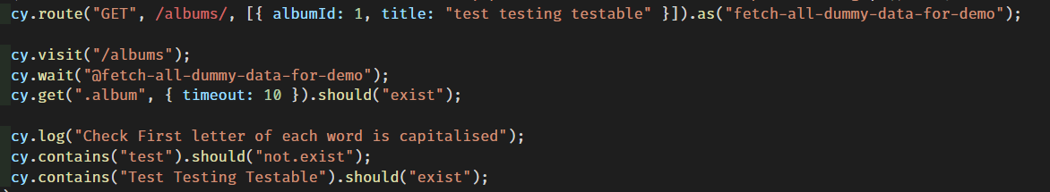
Better Options
Without mocking the data – just wait for the request to be made
and respond (also gives it a name in the console)
With mock data you can do environment agnostic tests

Slide 30
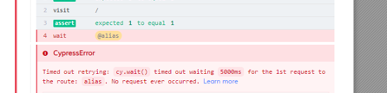
The more you know
Fetch not fully handled – but there is experimentalFetchPolyfill
The default retry timeout can be overridden
Timeouts create a minimum execution time

Slide 31
Some Good Ideas / “Best” Practices
Use data-* attributes to provide context to your selectors
Test in isolation
Tests should run independently
Unit Tests != Integration Tests != End to End Tests
Test Flows
Test integrations, but not all of them at once, mock/stub sensibly

Slide 33
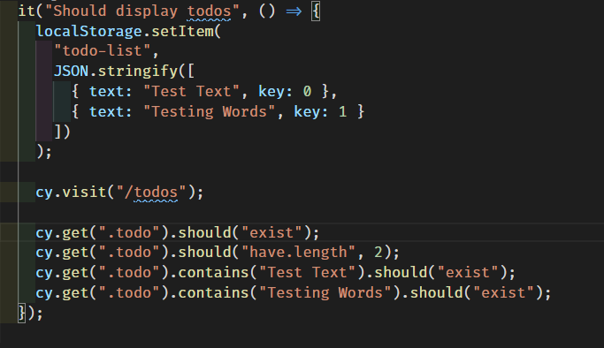
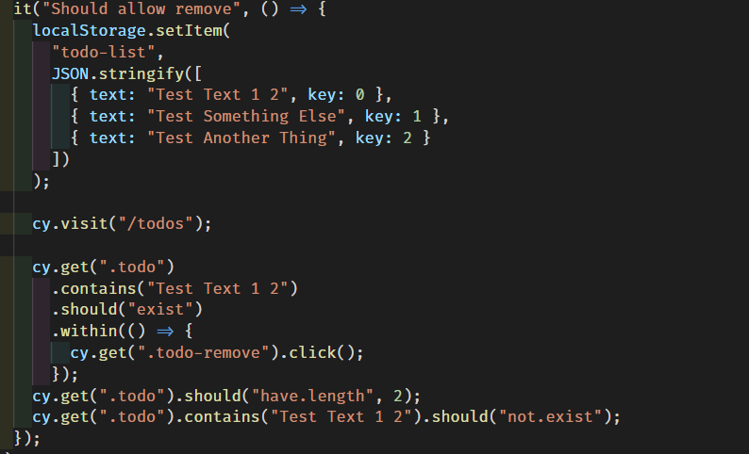

Slide 34
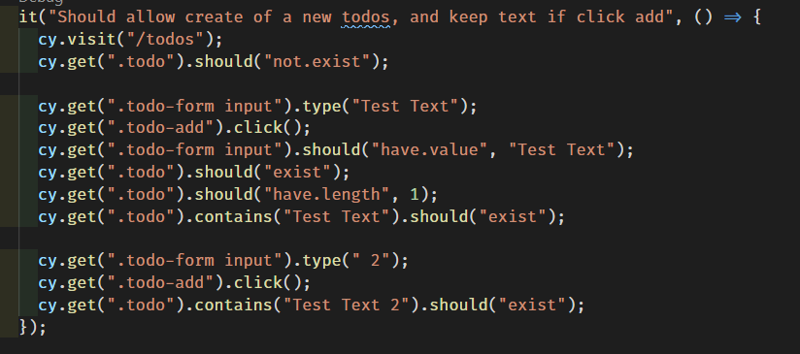
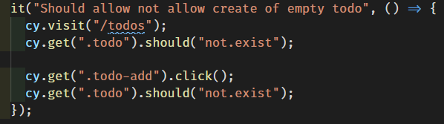

Slide 36

System Design / Design Patterns Intended to make software designs more understandable, flexible and maintainable
Whether it is intentional, systematic and consistent throughout, an organic spaghetti free for all or something in-between.
Once your code does multiple thing it starts to become a system, and it will have a design, chosen or evolved.
Methodologies exist to guide this process
Xtreme Programming
Clean Architecture
SOLID
How you separate your code (and name things) will affect how understandable, flexible and maintainable it will be.

Slide 37
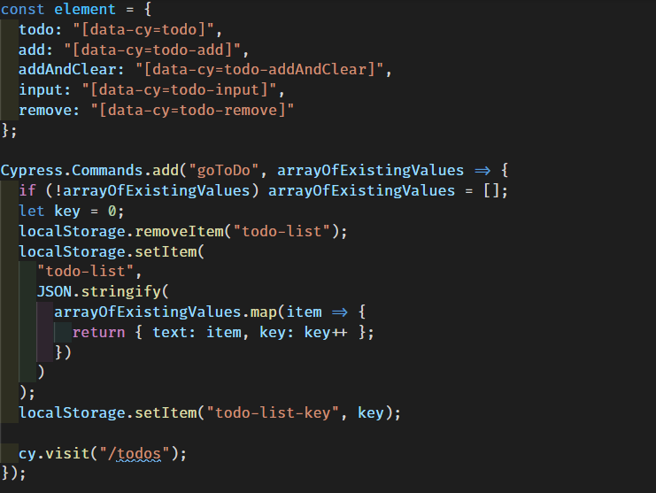

Slide 38
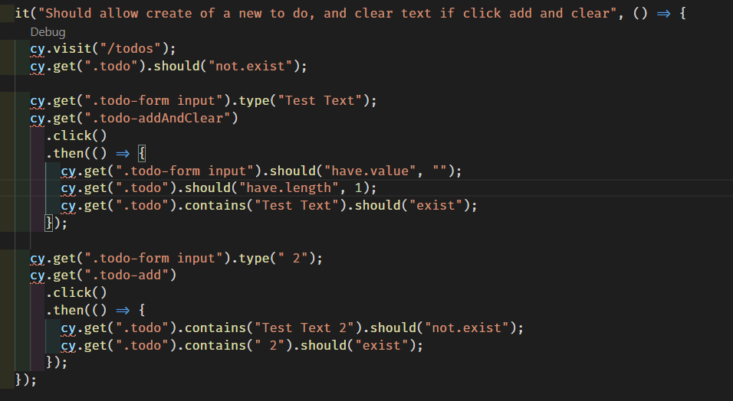
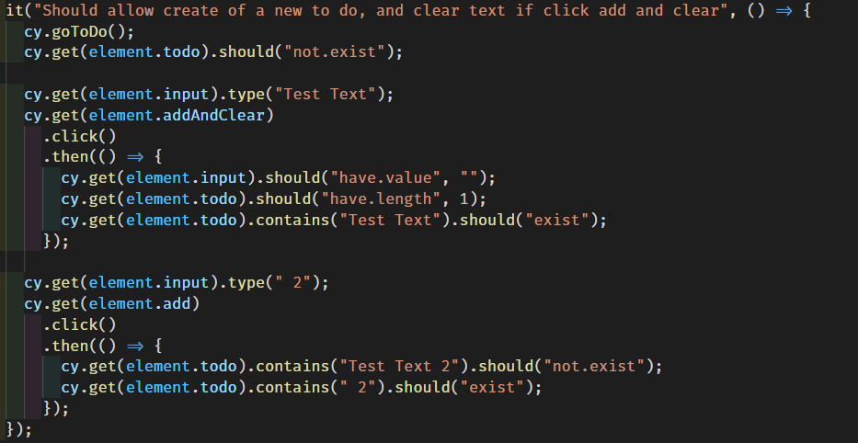

Slide 39
Challenge Time
How Maintainable, How Flexible is this set of tests?
Restyle ToDos with material UI
Remove all existing css styling classnames
How many changes are needed to fix the tests? (Could this have been less?)
Consider we were to add the ability to edit.

Slide 40
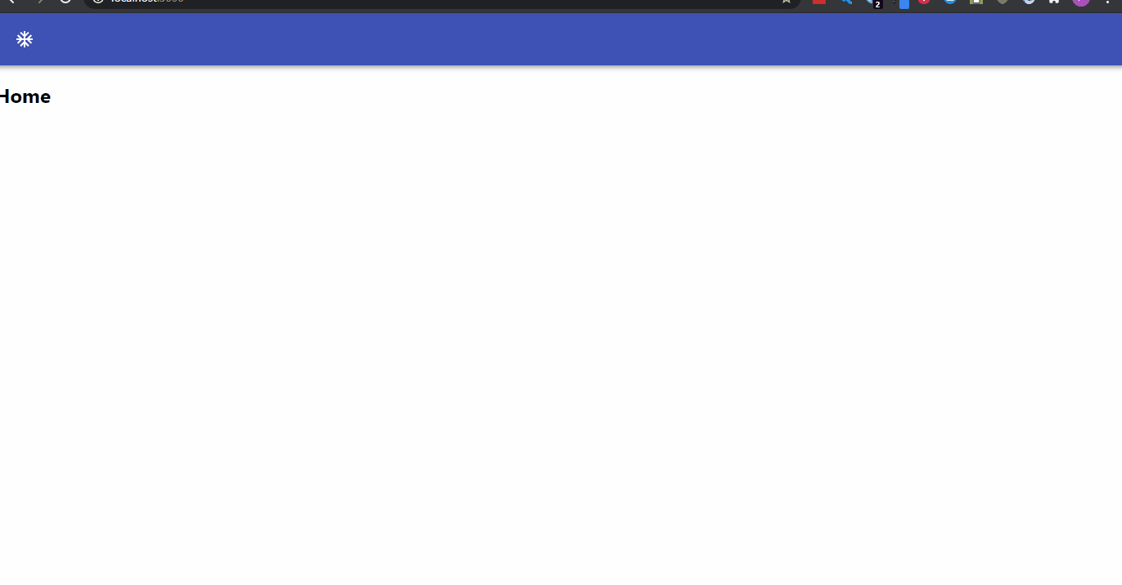
Restyled with Material-UI

Slide 41
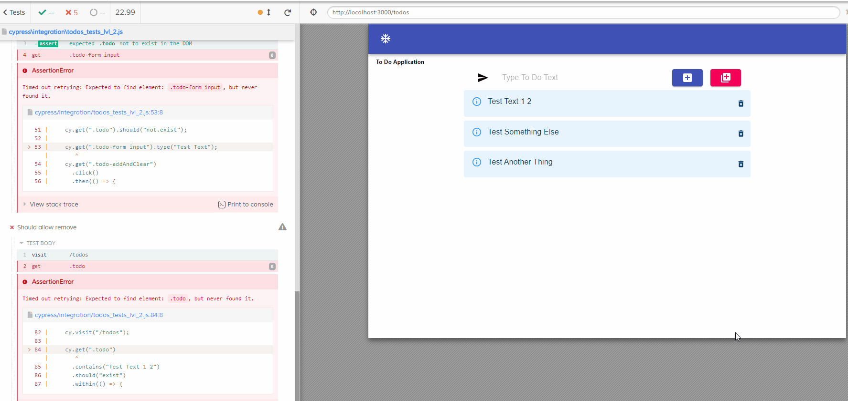

Slide 42
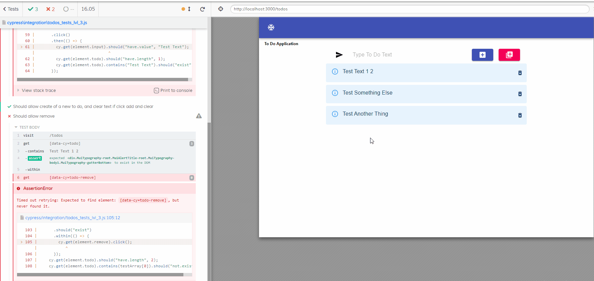

Slide 43
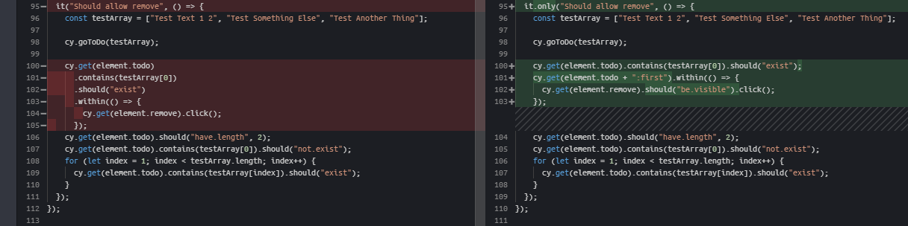

Slide 44


Final Thoughts… Further Reading…
The Xtreme Programming (XP) Wikipedia page, most programming “methodologies” begin here.
Some food for thought the next time you are trying to decide whether to (yes!) and how to (systematically!) split up the next system you work on.
Spare a thought for your future self
Keep it simple stupid
You ain’t gonna need it
Three strikes and you refactor (The Rule of 3)

